Slide 1
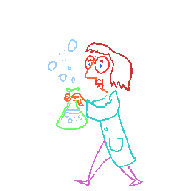
Classifying Chemical Reactions
Objectives:
1. Classify chemical reactions
2. Identify the characteristics of different classes of chemical reactions

Slide 2
Synthesis Reactions
Definition: a synthesis reaction is a chemical reaction in which two or more substances produce a single product
Synthesis reactions are sometimes called combination reactions because the reactants combine with each other to produce a single product

Slide 3
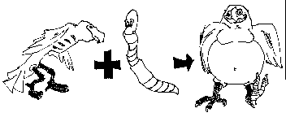
The reactants of the most common combination reactions are either 2 elements or 2 compounds
The product of a combination reaction is always a compound
Fe + S → FeS iron sulfide

Slide 4
OTHER EXAMPLES:
S + O₂→ SO₂ sulfur dioxide
2S + 3O₂→ 2SO₃ sulfur trioxide
Other examples of 2 compounds combining to become 1 product:
CaO + H₂O →Ca(OH)₂
2Na + Cl₂ → 2NaCl

Slide 5
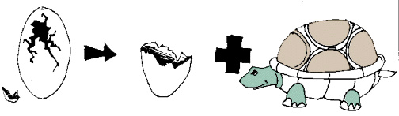
Decomposition Reactions
Some substances break down into simpler compounds when they react
These reactions may require heat or energy (from heat, light or electricity)
Definition: In decomposition reactions, a single compound is broken down into two or more products
In some ways a decomp reaction is the opposite of a synthesis reaction

Slide 6
MORE INFO & OTHER EXAMPLES
The products can be any combination of elements and compounds
It can be difficult to predict the products of decomposition reactions
Rapid decomp reactions can produce gaseous products can cause explosions
Ex: CaCO₃ → CaO + CO₂
Ex: NH₄NO₃ →N₂O +2H₂O

Slide 7

Combustion Reactions
Definition: a combustion reaction is when an element or compound reacts with oxygen, often producing energy as heat and light
If the supply of oxygen is insufficient during a reaction, combustion will be incomplete
Many reactions with oxygen as a reactant are classified as combustion reactions
Ex:C + O₂ → CO₂ (this is also a synthesis reaction)

Slide 8
We will consider the hydrocarbon plus oxygen reactions ONLY as combustion reactions
Combustion reactions can be tough to balance because you have O₂ as a reactant (2 oxygens) and H₂O as a product (1 oxygen)
2C₂H₁₈ + 25 O₂ →16CO₂ + 18H₂O
The products will be carbon dioxide and water
There are exceptions, but for now, look for the oxygen on the reactant side, & carbon dioxide and water on the product side for the hydrocarbon/oxygen reactions

Slide 9
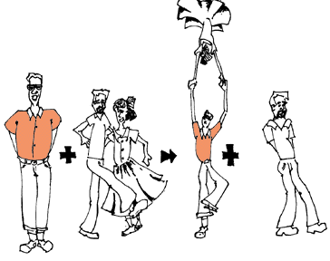
Single Replacement Reactions
Definition: in single replacement reactions, the atoms of one element replace the atoms of a second element in a compound
These are also called single displacement reactions
Ex: potassium replaces hydrogen (which is released as a flammable gas):2K + 2H₂O →2KOH +H₂

Slide 10
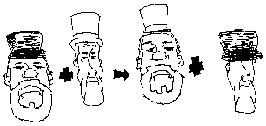
Double Replacement Reactions
Double replacement (displacement) reactions involve an exchange of positive ions between two reacting compounds
All double replacement reactions produce either water, a precipitate or a gas
Na₂S + Cd(NO₃)₂ → CdS + 2NaNO₃

Slide 11
EXAMPLES:
2NaCN + H₂SO₄ → 2HCN + Na₂SO₄
Ca(OH)₂ + 2HCl → CaCl₂ + 2H₂O

